Slide 1
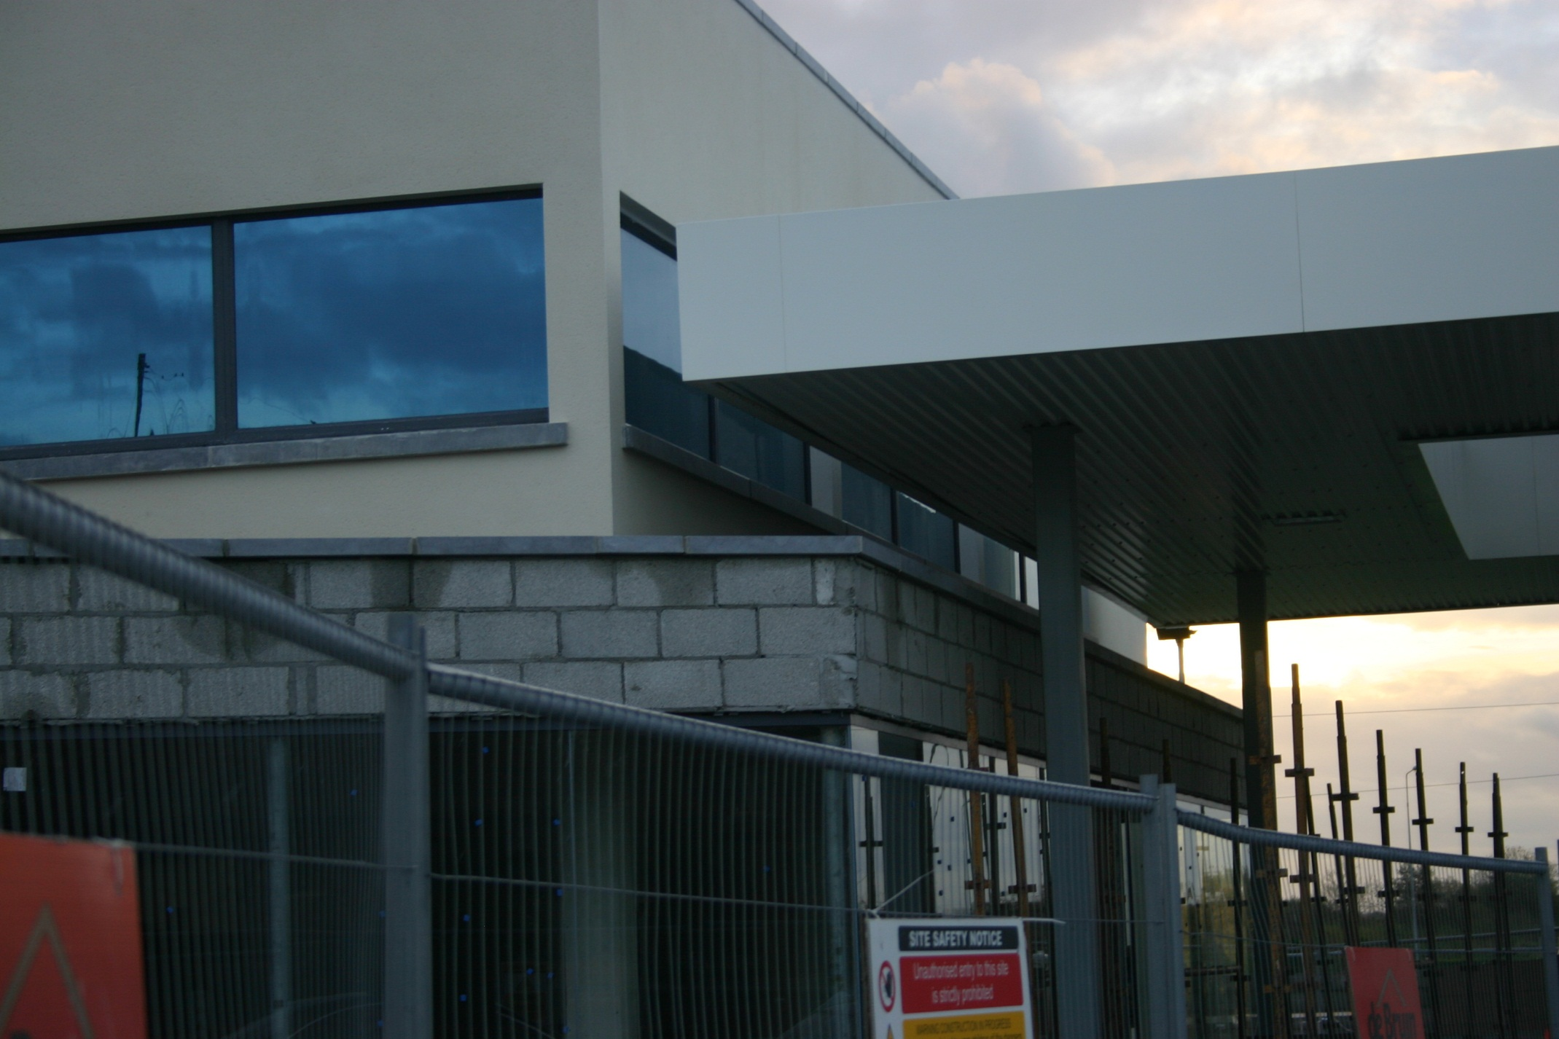
‘We don’t need to use 3D Design….’

Slide 2
Journal Seek

Slide 3

Basic Project Scheduling Line of Balance
Project Management
Year 4
Ref: Cooke B and Williams P (2009) Construction Planning, Programming & Control, Third Edition, Wiley-Blackwell Publishing, ISBN 978-1-4051-8380-2

Slide 4
Line of Balance
Consider the construction sequence below
Suppose this process is repeated over 8 similar or identical units (for instance houses)
Clearly it would be inefficient to have 8 versions of the construction sequence, all with their own EST’s, LST’s, etc.
For these types of project, ‘Line of Balance’ is selected.
LOB does not replace network logic; it supplements it
1
2
1
A
B
C

Slide 5
Line of Balance
First we construct a line
to represent activity A
This line starts at Unit 1 and 1
week later goes through Unit 2,
then U3 etc.
This line represents the start of
activity A on each of the units
8
7
6
Units
5
4
3
2
1
5
10
15
20
25
Weeks

Slide 6
Line of Balance
We now have the start of each
activity on each unit.
We now need to work out the finish
on each unit
This is done by constructing a
parallel line 1 week after the start
(as the activity duration is 1 week)
Then ‘cap’ it off.
8
7
6
Units
5
Activity A
4
3
2
1
5
10
15
20
25
Weeks

Slide 7
Line of Balance
If we look at this again, we can see
where the worker assigned to
activity A is at any time.
They start at unit 1, and 1 week
later start on unit 2, unit 3 etc.
8
7
6
Units
5
4
3
2
1
5
10
15
20
25
Weeks

Slide 8
Line of Balance
Next we need to consider activity B
We assume that the resources are
Different from those assigned to
Activity A
However we do allow a ‘buffer’ of
One week between the activities.
8
7
6
Units
5
Activity A
4
3
2
1
5
10
15
20
25
Weeks

Slide 9
Line of Balance
8
7
6
We can very quickly
see that activity B is
proceeding at a slower
rate than activity A
The 1 week buffer,
becomes 8 weeks by
unit 8
Units
5
Activity A
Activity B
4
3
2
1
5
10
15
20
25
Weeks

Slide 10
Line of Balance
8
7
6
We can very quickly
see that activity B is
proceeding at a slower
rate than activity A
The 1 week buffer,
becomes 8 weeks by
unit 8
Units
5
Activity A
4
3
2
1
5
10
15
20
25
Weeks

Slide 11
Line of Balance
8
7
6
Units
5
Activity A
Activity B
Activity C
4
Finally, we add activity C
Clearly, this schedule is
inefficient
3
2
1
5
10
15
20
25
Weeks

Slide 12
Line of Balance
8
At present we have a completion at week 20
Activity B is proceeding slower than the other activities.
Considerable time savings could be achieved if Activity B was completed sooner; or brought parallel to activity A and C
We can bring activity B parallel with the others, by increasing the number of resources assigned to B
7
6
Units
5
Activity A
Activity B
Activity C
4
3
2
1
5
10
15
20
25
Weeks

Slide 13
Line of Balance
8
7
6
Units
We double the resources assigned to Activity B
5
Activity A
Activity C
4
3
2
1
5
10
15
20
25
Weeks

Slide 14
Line of Balance
8
We double the resources assigned to Activity B
Once Activity B is brought parallel, we can commence activity C earlier without clashing.
By doing this we shorten the overall project duration from 20 weeks to 13 weeks.
7
6
Units
5
Activity A
Activity B
Activity C
4
3
2
1
5
10
13
15
20
25
Weeks

Slide 15
Line of Balance – SS relationship
Buffer
8
Overall Duration
7
6
5
4
3
2
1
Minimum Buffer

Slide 16
Line of Balance – FF relationship
Buffer
8
Overall Duration
7
6
5
4
3
2
1
Minimum Buffer

Slide 17
Line of Balance Example 2
Consider the project below which consists of 5 construction activities
The contractor will be constructing 10 houses in the above sequence
Activity | Duration (weeks) | Number of Gangs
Foundations | 2 | 2
External Walls | 4 | 3
Roof Construction | 1 | 1
Internal Finishes | 4 | 3
External Works | 2 | 2
2
4
1
4
2
Foundations
External Walls
Roof
Internal Finish
External Wrks
Ref: Cooke B and Williams P (2009) Construction Planning, Programming & Control, Third Edition, Wiley-Blackwell Publishing, ISBN 978-1-4051-8380-2

Slide 18
The mathematical relationship between the duration of an activity and the number of crews can be expressed as:
For Activity ‘Foundations’ this is
Which means that the last start of ‘Foundations’ is on week 9

Slide 19
Line of Balance – Example 2
10
9
8
7
6
Number of House Units
Foundations
5
4
3
2
1
5
10
15
20
25
30
35
Weeks
Ref: Cooke B and Williams P (2009) Construction Planning, Programming & Control, Third Edition, Wiley-Blackwell Publishing, ISBN 978-1-4051-8380-2

Slide 20
Line of Balance – Example 2
10
9
8
7
Now we consider the external walls
6
Number of House Units
Foundations
External Walls
5
And allow a 1 week buffer between the activities
The activity starts on W3; so last unit will start 12 weeks later on week 15
4
3
2
1
5
10
15
20
25
30
35
Weeks
Ref: Cooke B and Williams P (2009) Construction Planning, Programming & Control, Third Edition, Wiley-Blackwell Publishing, ISBN 978-1-4051-8380-2

Slide 21
Line of Balance – Example 2
We now need to consider the roof.
It is good practice to run a quick test to determine if the buffer should be applied at the start or end of the activity
We examine the slope of the lines for the External Walls and the Roof
External walls:
Roof:

Slide 22
Line of Balance – Example 2
External walls:
Roof:
The slope of the ‘External Walls’ activity is 1.33
The slope of the ‘Roof’ activity is 1.00
The lower the number the faster the rate of progress
So in this case we can see that the Roof will progress at a faster rate than the External Walls
Because of this, we need to allow the 1 week buffer at the start of Unit 10; otherwise the program will clash

Slide 23
Line of Balance – Example 2
10
9
8
7
6
Number of House Units
Roof:
Foundations
External Walls
5
4
We have already determined that the buffer should be allowed on Unit 10 so we draw in the Roof activity
3
2
1
5
10
15
20
25
30
35
Weeks
Ref: Cooke B and Williams P (2009) Construction Planning, Programming & Control, Third Edition, Wiley-Blackwell Publishing, ISBN 978-1-4051-8380-2

Slide 24
Line of Balance – Example 2
10
9
8
7
6
Number of House Units
Roof:
Foundations
External Walls
Roof
5
4
We have already determined that the buffer should be allowed on Unit 10 so we draw in the Roof activity
3
2
1
5
10
15
20
25
30
35
Weeks
Ref: Cooke B and Williams P (2009) Construction Planning, Programming & Control, Third Edition, Wiley-Blackwell Publishing, ISBN 978-1-4051-8380-2

Slide 25
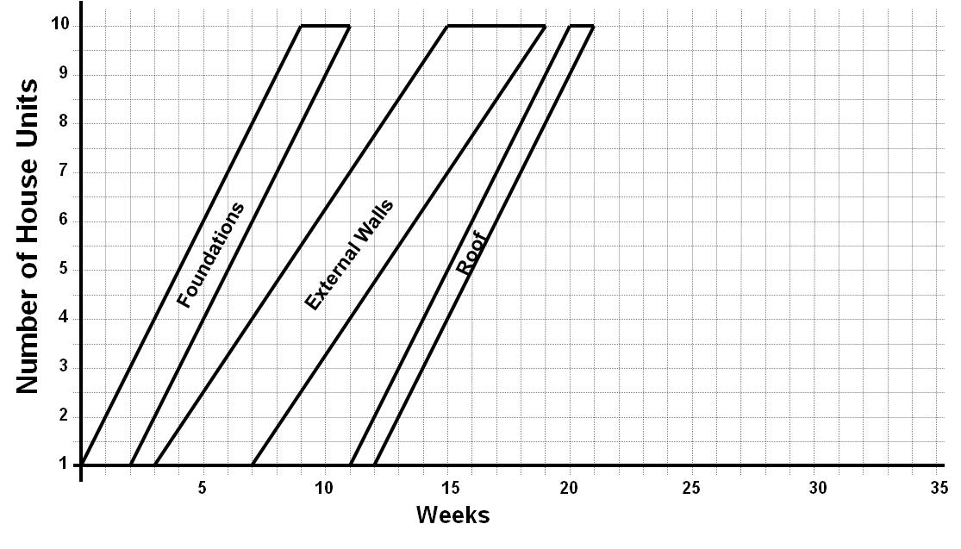
Line of Balance – Example 2
The calculations for each activity can be run at the start of the analysis
It is in fact normal practice to do so..
slope of ‘Roof’: 1.00
slope of ‘Internal Finish’: 1.33; therefore buffer at Unit 1
slope of ‘External Works’: 1.00; therefore buffer at Unit 10
Duration of ‘Internal Finish’: 12 weeks
Duration of ‘External Works’: 9 weeks

Slide 26
Line of Balance – Example 2
10
9
8
7
6
Number of House Units
Foundations
External Walls
Roof
Internal Finish
External Works
5
4
3
2
1
5
10
15
20
25
30
35
Weeks
Ref: Cooke B and Williams P (2009) Construction Planning, Programming & Control, Third Edition, Wiley-Blackwell Publishing, ISBN 978-1-4051-8380-2

Slide 27
Line of Balance – Example 2
10
9
8
7
6
Number of House Units
Completion on Week 32
Foundations
External Walls
Roof
Internal Finish
External Works
5
4
3
2
1
5
10
15
20
25
30
35
Weeks
Ref: Cooke B and Williams P (2009) Construction Planning, Programming & Control, Third Edition, Wiley-Blackwell Publishing, ISBN 978-1-4051-8380-2

Slide 28
What else can we determine?
We have determined that completion of unit 10 should occur at the end of week 32
We also have start and end times for all of the activities
Foundations – start week 0: finish week 11
External Walls – start week 3: finish week 19
Roof – start week 11: finish week 21
Internal Finish - start week 13: finish week 29
External Works - start week 21: finish week 32

Slide 29
What else can we determine?
We can also pin-point progress at any point in time:
For instance at week 15 all foundations should be complete; the last of the external walls should be starting, the roof should be complete on Unit 4, and internal finishes should be 50% complete on Unit 1 and 25% complete on Unit 2

Slide 30
What else can we determine?
We can also examine the schedule on a particular unit:
Unit 6 should commence on week 5 and be complete by week 28; the roof should be complete by week 17, and any decisions in relation to paint colour etc. must be made by the purchaser before week 19

Slide 31
Mathematical Method
The solutions presented use a graphical method
Line of balance can also be solved using a mathematical method or algorithm

Slide 32
Mathematical Method
Construct the Table as shown

Slide 33
Mathematical Method
Calculate the slope of each balance line using the equation

Slide 34
Mathematical Method
Compare the slopes
In this case 1.33 is larger than 1.00, therefore the slope goes to the bottom of the graph

Slide 35
Mathematical Method
An easy way to remember is:
‘the buffer goes to the location of the larger of the two numbers being compared’

Slide 36
Mathematical Method
In this case the larger number is on the top

Slide 37
Mathematical Method
So the buffer goes to the top

Slide 38
Mathematical Method
And so on

Slide 39
Mathematical Method
And so on…

Slide 40
Mathematical Method
Add in the total activity durations using

Slide 41
Mathematical Method
This is the same as:

Slide 42
Mathematical Method
Now insert the buffers

Slide 43
Mathematical Method
Foundations start at time 0.00 and finishes 2 days later

Slide 44
Mathematical Method
Foundations on Unit 10 will start 9 days after the start of Unit 1

Slide 45
Mathematical Method
Foundations on Unit 1 will finish 2 days later

Slide 46
Mathematical Method
We have already determined that the buffer between ‘Foundations’ and ‘External Walls’ goes to the bottom

Slide 47
Mathematical Method
Therefore ‘External Walls’ will commence one day after the finish of ‘Foundations’ on Unit 1; which is Day 3

Slide 48
Mathematical Method
‘External Walls’ will take 4 days. As this commenced on Day 3, it will be finished 4 days later on Day 7

Slide 49
Mathematical Method
Unit 10 will start 12 days later on Day 15
And will finish on Day 19

Slide 50
Mathematical Method
Next we have the roof. The buffer goes to the ‘top’
Therefore we start unit 10 on Day 20 and complete
1 days later on Day 21

Slide 51
Mathematical Method
Construct the Table as shown

Slide 52
Mathematical Method
We can now work backwards to determine when
Unit 1 should start and finish

Slide 53
Mathematical Method
And the process continues on.

Slide 54
Mathematical Method
And the process continues on.

Slide 55
Mathematical Method
And the process continues on.

Slide 56
Mathematical Method
And the process continues on.

Slide 57
Mathematical Method
Once complete each of the 4 points of the
Balance Line have been determined, so the
diagram can be constructed

Slide 58
Further Reading
Cooke B. and Williams P. (2009) Construction Planning, Programming & Control, Third Edition, Wiley-Blackwell Publishing, Chapter 9
ISBN 978-1-4051-8380-2

Slide 59

Next Lectures
Time Distance
Reading: ‘A Guide to the Project Management Body of Knowledge’ Chapters 5 & 6

